Slide 1

The plot of our course
Felipe Buchbinder

Slide 2

When we build a regression model, we would like it to contain all X’s that are important to explain our Y…
Unfortunately,
this is not always possible.

Slide 3

Why not?

Slide 4
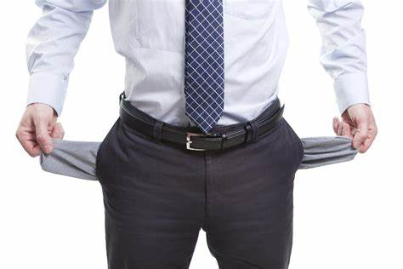
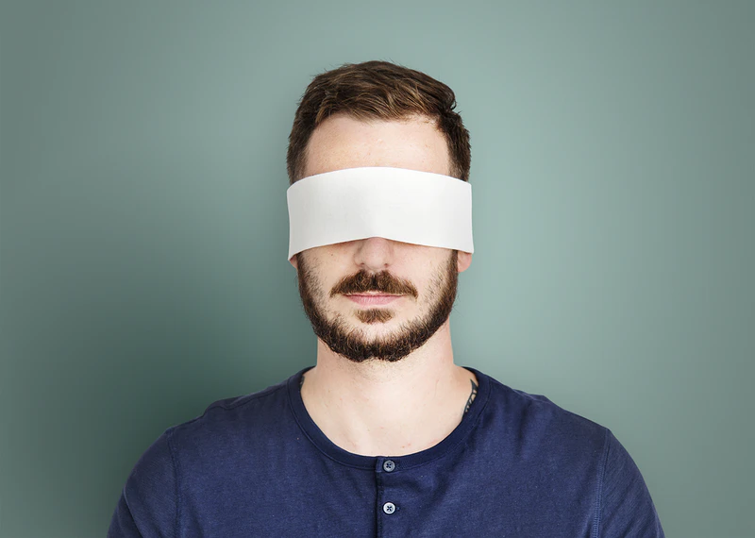
We might not have all the variables
Some variables may not be observable

Slide 5
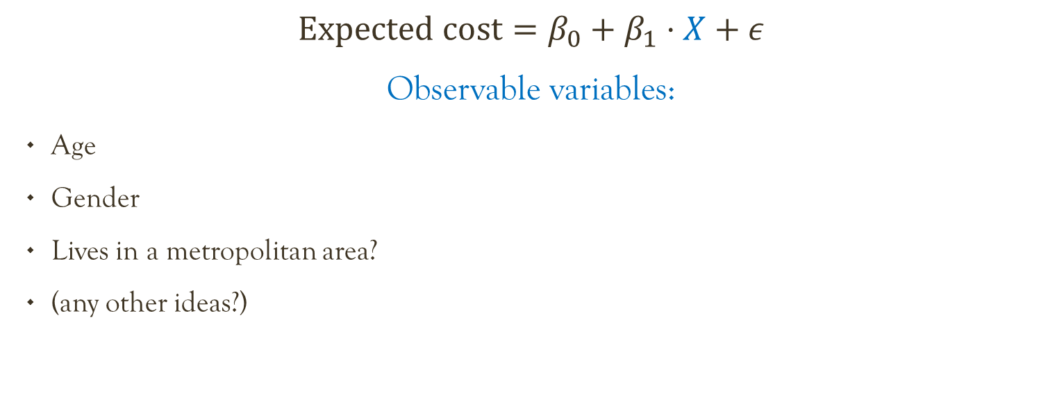
Car insurance
$$Expected cost=β_{0}+β_{1}⋅X+ε$$
Observable variables:
Age
Gender
Lives in a metropolitan area?
(any other ideas?)

Slide 6
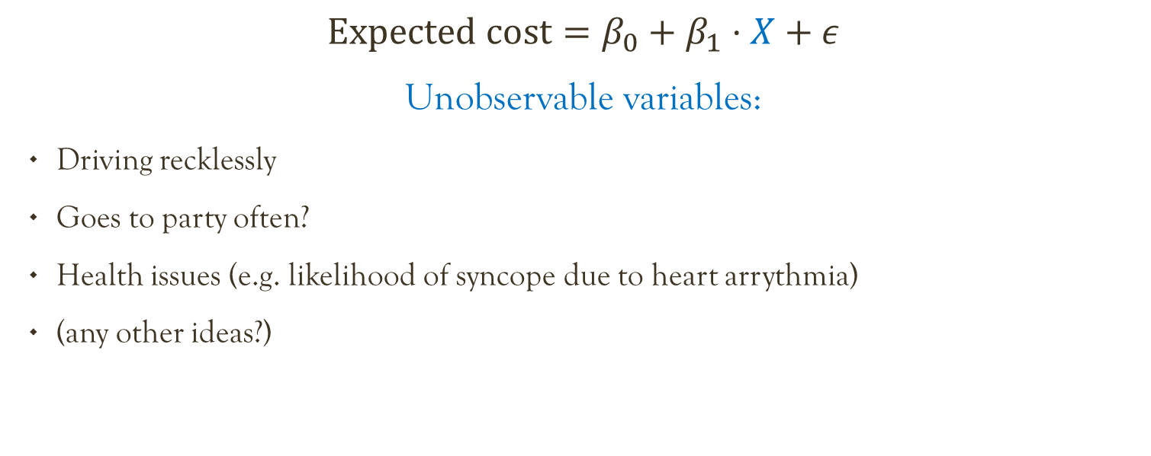
Car insurance
$$Expected cost=β_{0}+β_{1}⋅X+ε$$
Unobservable variables:
Driving recklessly
Goes to party often?
Health issues (e.g. likelihood of syncope due to heart arrythmia)
(any other ideas?)

Slide 7
Another example: Impact of democracy on child mortality
Ross, M. (2006). Is democracy good for the poor?. American Journal of Political Science, 50(4), 860-874.

Slide 8
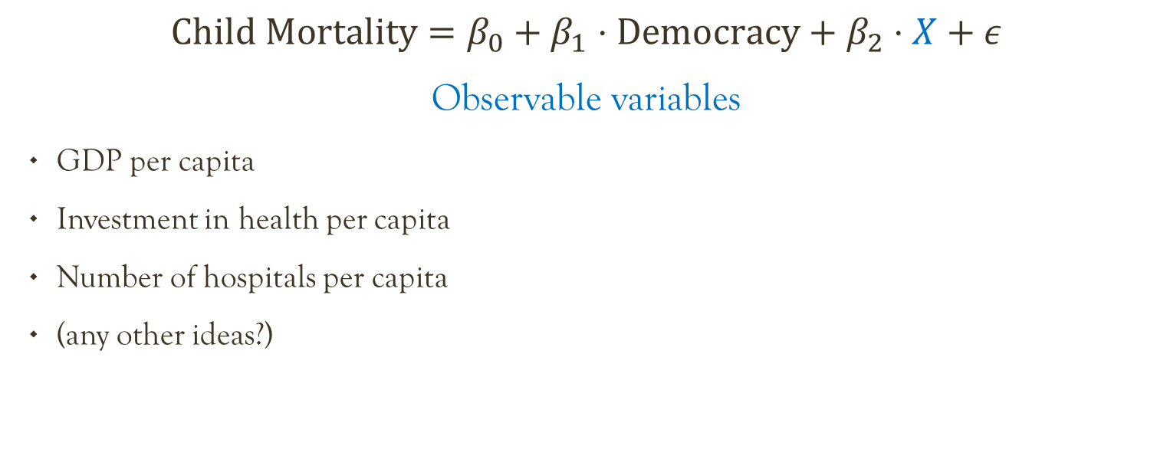
$$Child Mortality=β_{0}+β_{1}⋅Democracy+β_{2}⋅X+ε$$
Observable variables
GDP per capita
Investment in health per capita
Number of hospitals per capita
(any other ideas?)

Slide 9
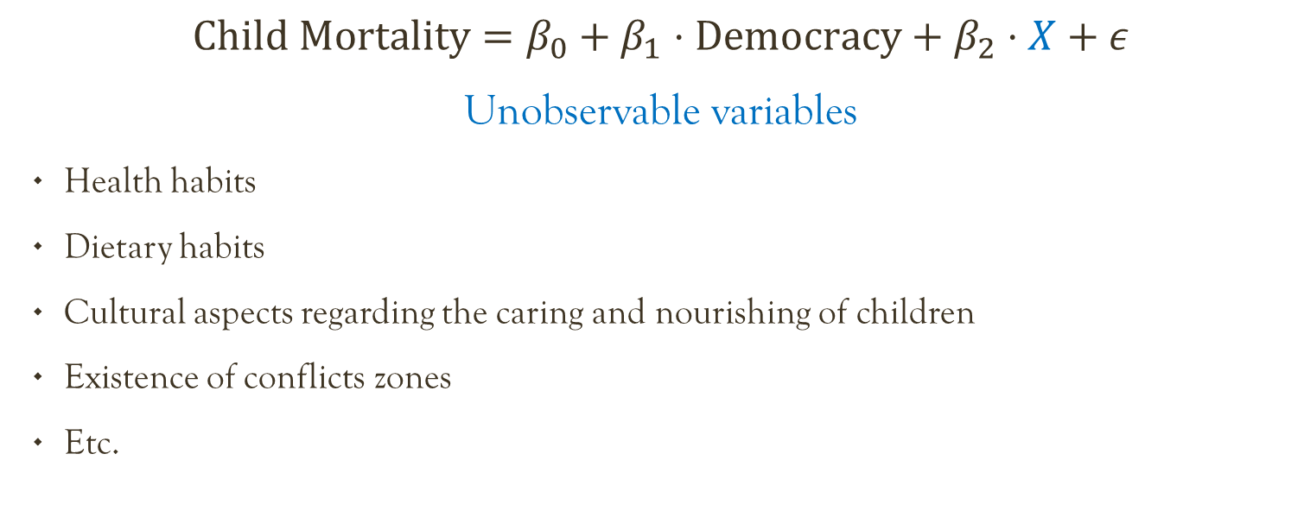
$$Child Mortality=β_{0}+β_{1}⋅Democracy+β_{2}⋅X+ε$$
Unobservable variables
Health habits
Dietary habits
Cultural aspects regarding the caring and nourishing of children
Existence of conflicts zones
Etc.

Slide 10
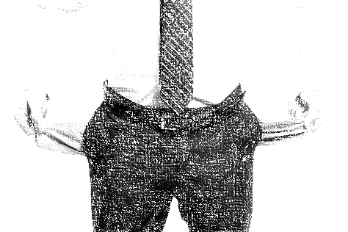
Variables that differ between entities but are not observable are called unobserved heterogeneities.
We might not have all the variables
Some variables may not be observable

Slide 11
When we build a regression model, we would like it to contain all X’s that are important to explain our Y…
Unfortunately,
this is not always possible.

Slide 12
When an important X is missing in our model, bad things can happen.

Slide 13

For example…?

Slide 14

Biased regression coefficients

Slide 15
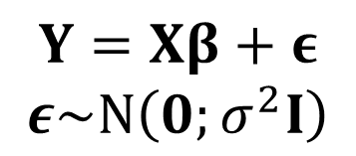
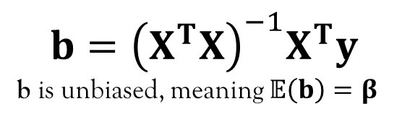
Linear Regression refresher
$$Y=Xβ+ε$$
$$ε\sim N\left(0;σ^{2}I\right)$$
$$b={\left(X^{T}X\right)}^{−1}X^{T}y$$
b is unbiased, meaning $𝔼\left(b\right)=β$

Slide 16
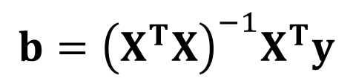
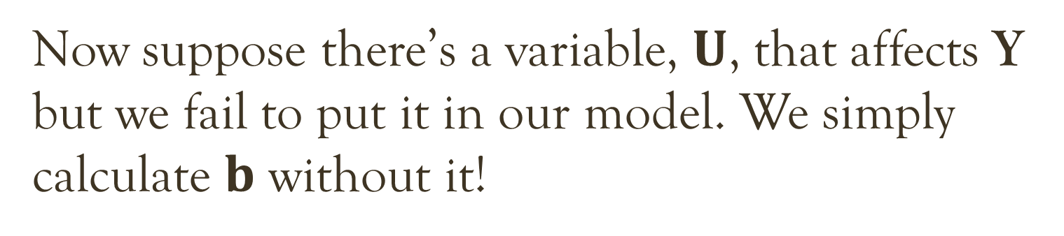
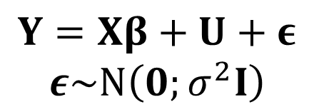
Now suppose there’s a variable, $U$, that affects Y but we fail to put it in our model. We simply calculate $b$ without it!
$$Y=Xβ+U+ε$$
$$ε\sim N\left(0;σ^{2}I\right)$$
$$b={\left(X^{T}X\right)}^{−1}X^{T}y$$

Slide 17
Now suppose there’s a variable, $U$, that affects Y but we fail to put it in our model. We simply calculate $b$ without it!
$$Y=Xβ+U+ε$$
$$ε\sim N\left(0;σ^{2}I\right)$$
$$b={\left(X^{T}X\right)}^{−1}X^{T}y$$
In this case, $b$ is no longer an unbiased estimate of $β!$

Slide 18
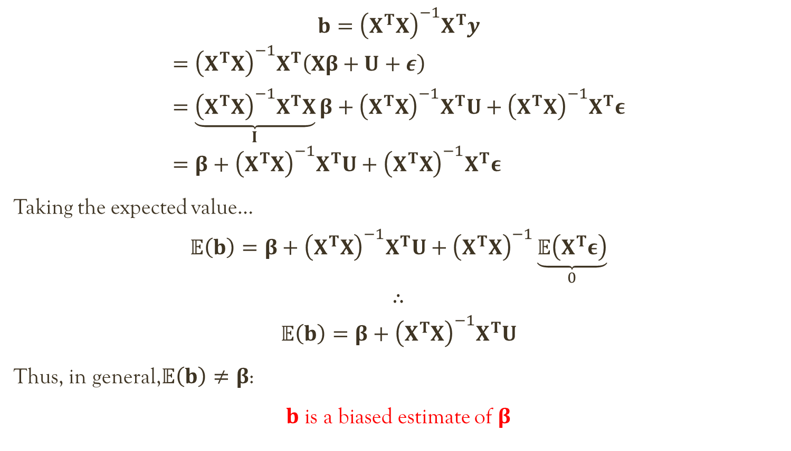
$$b={\left(X^{T}X\right)}^{−1}X^{T}y$$
$$={\left(X^{T}X\right)}^{−1}X^{T}\left(Xβ+U+ε\right) \\ =\underset{I}{\underbrace{{\left(X^{T}X\right)}^{−1}X^{T}X}}β+{\left(X^{T}X\right)}^{−1}X^{T}U+{\left(X^{T}X\right)}^{−1}X^{T}ε \\ =β+{\left(X^{T}X\right)}^{−1}X^{T}U+{\left(X^{T}X\right)}^{−1}X^{T}ε$$
Taking the expected value…
$$𝔼\left(b\right)=β+{\left(X^{T}X\right)}^{−1}X^{T}U+{\left(X^{T}X\right)}^{−1}\underset{0}{\underbrace{𝔼\left(X^{T}ε\right)}}$$
$$∴$$
$$𝔼\left(b\right)=β+{\left(X^{T}X\right)}^{−1}X^{T}U$$
Thus, in general,$𝔼\left(b\right)≠β$:
$b$ is a biased estimate of $β$

Slide 19
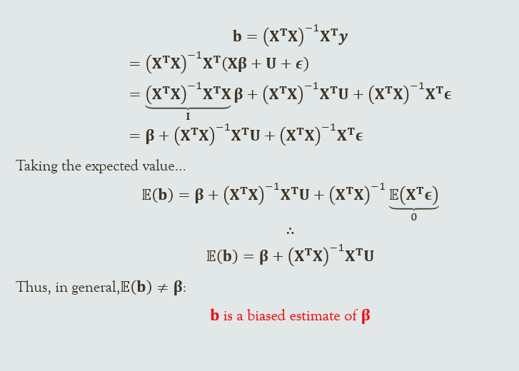
I propose a name for this Theorem…

Slide 20

Maleficent's Theorem A variable that wasn’t invited to a regression will curse the coefficients of those that were, making them biased

Slide 21
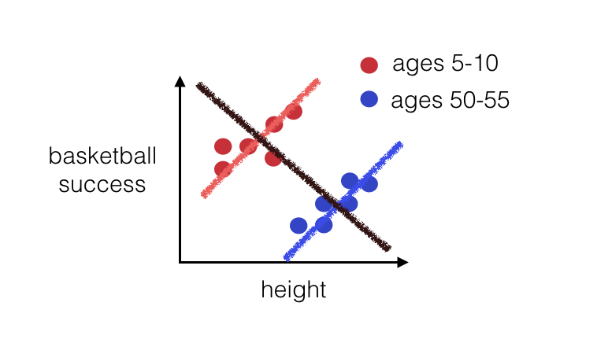
An extreme scenario: Simpson’s Paradox
Wanna be good at Basketball? Be short!

Slide 22

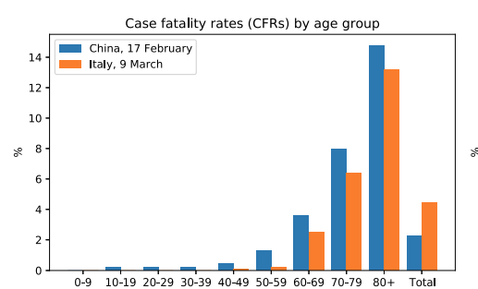

Slide 23
When we build a regression model, we would like it to contain all X’s that are important to explain our Y…
Unfortunately,
this is not always possible.

Slide 24
When an important X is missing in our model, bad things can happen.
Our course is about
how to build good models even when we cannot have all the important X’s in it.

Slide 25

Our strategy will be to analyze things over time, so we can have a feeling of how things usually are. If an X matters, it’s effect should be made visible by observing something over time and comparing it with others.

Slide 26

Why do we date before we get engaged?

Slide 27
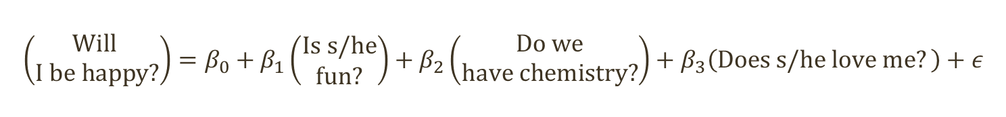
$$\left(\begin{aligned}Will \\ I be happy?\end{aligned}\right)=β_{0}+β_{1}\left(\begin{aligned}Is s/he \\ fun?\end{aligned}\right)+β_{2}\left(\begin{aligned}Do we \\ have chemistry?\end{aligned}\right)+β_{3}\left(Does s/he love me?\right)+ε$$

Slide 28
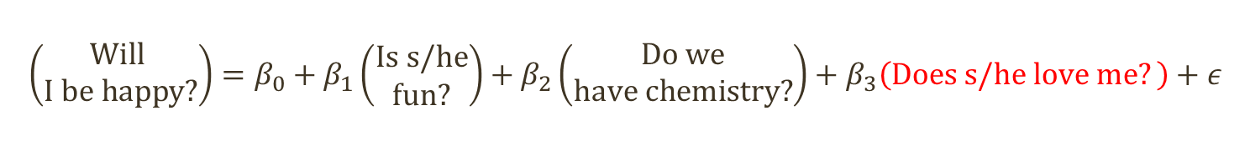
$$\left(\begin{aligned}Will \\ I be happy?\end{aligned}\right)=β_{0}+β_{1}\left(\begin{aligned}Is s/he \\ fun?\end{aligned}\right)+β_{2}\left(\begin{aligned}Do we \\ have chemistry?\end{aligned}\right)+β_{3}\left(Does s/he love me?\right)+ε$$
Unobservable

Slide 29
$$\left(\begin{aligned}Will \\ I be happy?\end{aligned}\right)=β_{0}+β_{1}\left(\begin{aligned}Is s/he \\ fun?\end{aligned}\right)+β_{2}\left(\begin{aligned}Do we \\ have chemistry?\end{aligned}\right)+β_{3}\left(Does s/he love me?\right)+ε$$
Unobservable
Over time, you’ll see how
s/he usually acts towards you.

Slide 30
$$\left(\begin{aligned}Will \\ I be happy?\end{aligned}\right)=β_{0}+β_{1}\left(\begin{aligned}Is s/he \\ fun?\end{aligned}\right)+β_{2}\left(\begin{aligned}Do we \\ have chemistry?\end{aligned}\right)+β_{3}\left(Does s/he love me?\right)+ε$$
Unobservable
Over time, you’ll see how
s/he usually acts towards you.
By dating other people
(not at once! ☺ )
you’ll be able to see how other people usually treat you
and assess if s/he is special

Slide 31
$$\left(\begin{aligned}Will \\ I be happy?\end{aligned}\right)=β_{0}+β_{1}\left(\begin{aligned}Is s/he \\ fun?\end{aligned}\right)+β_{2}\left(\begin{aligned}Do we \\ have chemistry?\end{aligned}\right)+β_{3}\left(Does s/he love me?\right)+ε$$
Unobservable
Over time, you’ll see how
s/he usually acts towards you.
By dating other people
(not at once! ☺ )
you’ll be able to see how other people usually treat you
and assess if s/he is special

Slide 32
A less silly example: Impact of democracy on child mortality
Ross, M. (2006). Is democracy good for the poor?. American Journal of Political Science, 50(4), 860-874.

Slide 33
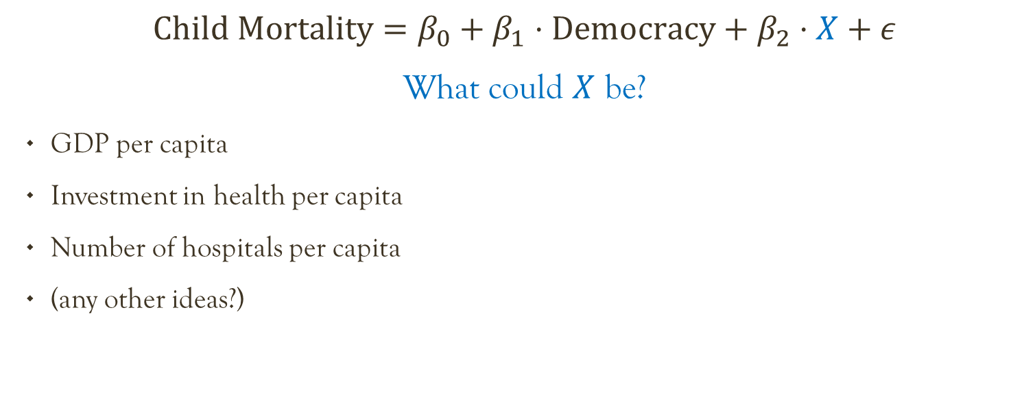
What control variables would you use in this model?
$$Child Mortality=β_{0}+β_{1}⋅Democracy+β_{2}⋅X+ε$$
What could $X$ be?
GDP per capita
Investment in health per capita
Number of hospitals per capita
(any other ideas?)

Slide 34
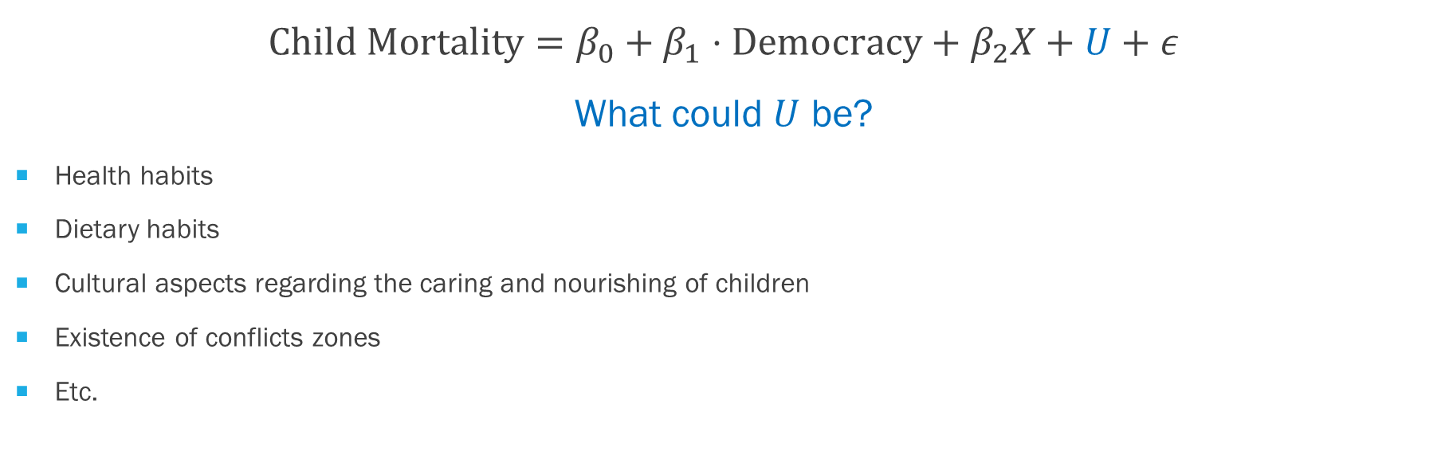
Some things that affect child mortality are unobserved
$$Child Mortality=β_{0}+β_{1}⋅Democracy+β_{2}X+U+ε$$
What could $U$ be?
Health habits
Dietary habits
Cultural aspects regarding the caring and nourishing of children
Existence of conflicts zones
Etc.

Slide 35
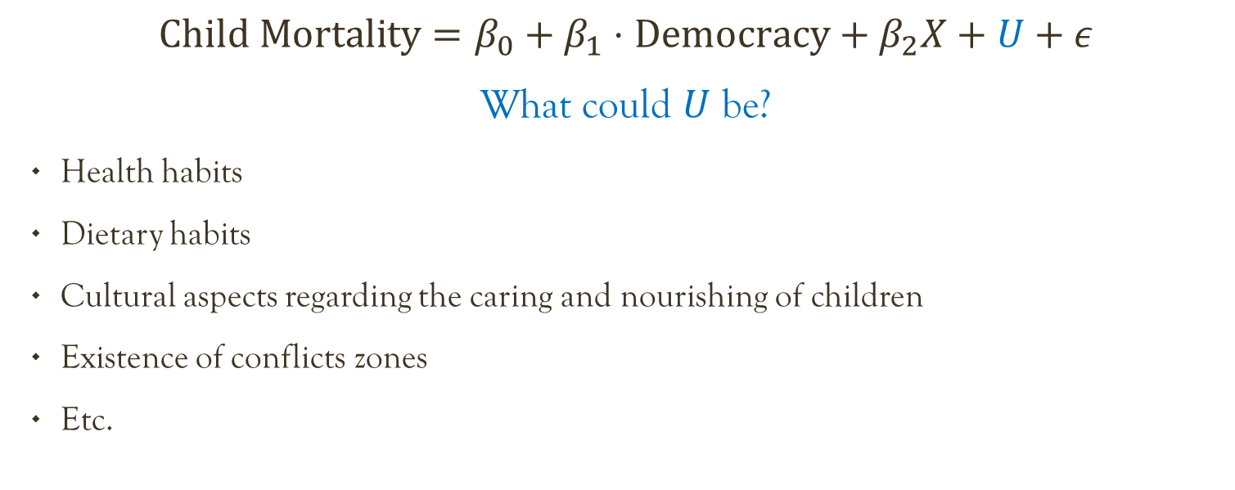
Some things that affect child mortality are unobserved
$$Child Mortality=β_{0}+β_{1}⋅Democracy+β_{2}X+U+ε$$
What could $U$ be?
Health habits
Dietary habits
Cultural aspects regarding the caring and nourishing of children
Existence of conflicts zones
Etc.
We can get a sense of these
by observing many countries over time

Slide 36
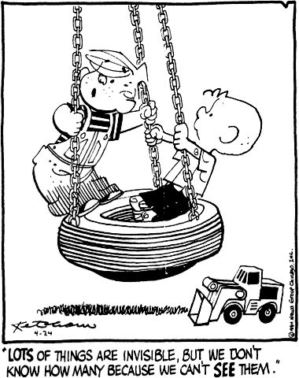

Slide 37


Slide 38

To deal with unobserved heterogeneities, we’ll observe many entities over time

Slide 39

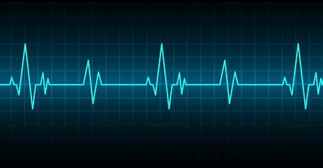


4 kinds of data
Cross-Sectional
Time Series
Pooled
Panel

Slide 40
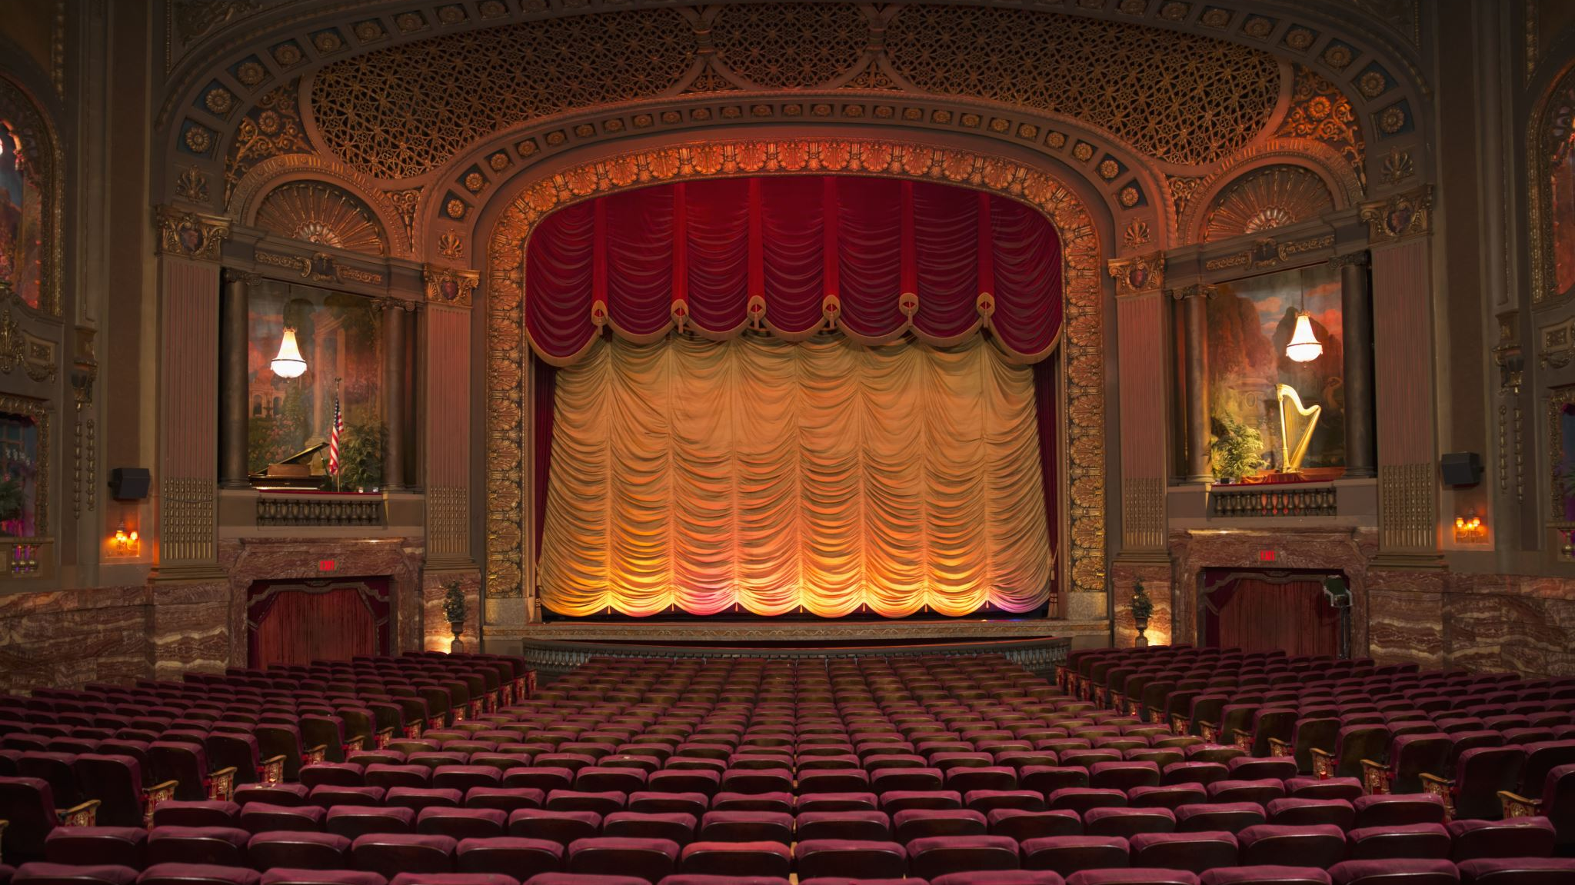
The general panel data model a.k.a. the most important equation in our course

Slide 41
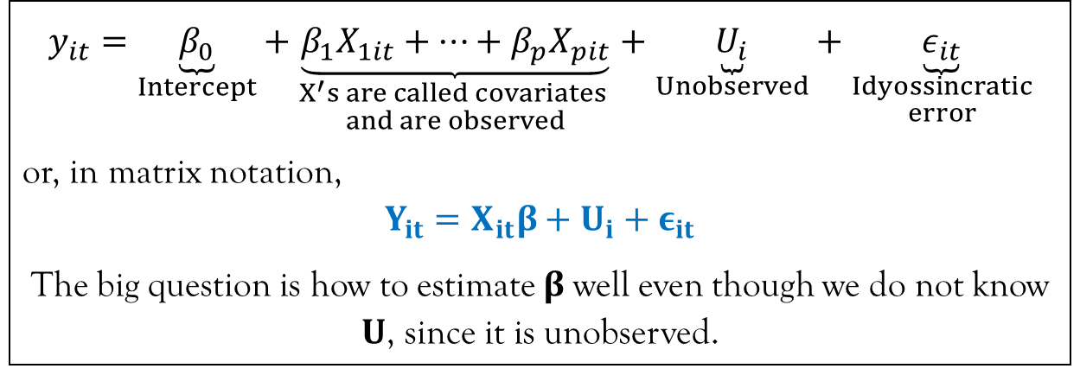
The general panel data model a.k.a. the most important equation in our course
$$y_{it}=\underset{Intercept}{\underbrace{β_{0}}}+\underset{\begin{aligned}X^{′}s are called covariates \\ and are observed\end{aligned}}{\underbrace{β_{1}X_{1it}+…+β_{p}X_{pit}}}+\underset{Unobserved}{\underbrace{U_{i}}}+\underset{\begin{aligned}Idyossincratic \\ error\end{aligned}}{\underbrace{ε_{it}}}$$
or, in matrix notation,
$$Y_{it}=X_{it}β+U_{i}+ε_{it}$$
The big question is how to estimate $β$well even though we do not know $U$, since it is unobserved.

Slide 42
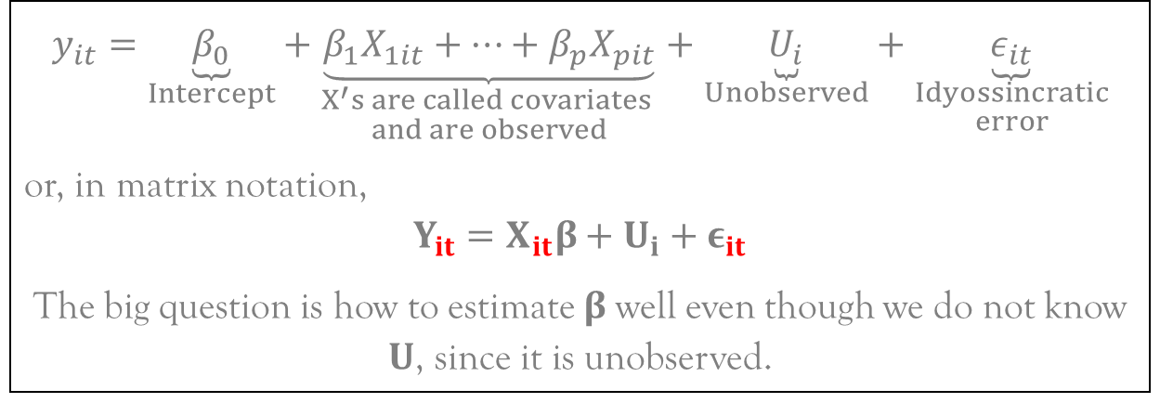
The general panel data model a.k.a. the most important equation in our course
$$y_{it}=\underset{Intercept}{\underbrace{β_{0}}}+\underset{\begin{aligned}X^{′}s are called covariates \\ and are observed\end{aligned}}{\underbrace{β_{1}X_{1it}+…+β_{p}X_{pit}}}+\underset{Unobserved}{\underbrace{U_{i}}}+\underset{\begin{aligned}Idyossincratic \\ error\end{aligned}}{\underbrace{ε_{it}}}$$
or, in matrix notation,
$$Y_{it}=X_{it}β+U_{i}+ε_{it}$$
The big question is how to estimate $β$well even though we do not know $U$, since it is unobserved.
Over time, you’ll see how
s/he usually acts towards you.
Data is for each entity
at each time → Panel Data

Slide 43
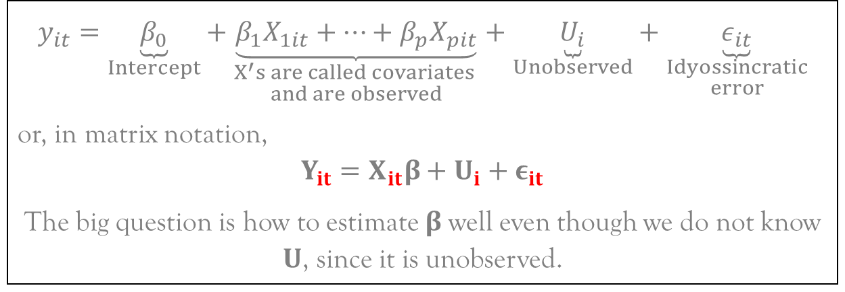
The general panel data model a.k.a. the most important equation in our course
$$y_{it}=\underset{Intercept}{\underbrace{β_{0}}}+\underset{\begin{aligned}X^{′}s are called covariates \\ and are observed\end{aligned}}{\underbrace{β_{1}X_{1it}+…+β_{p}X_{pit}}}+\underset{Unobserved}{\underbrace{U_{i}}}+\underset{\begin{aligned}Idyossincratic \\ error\end{aligned}}{\underbrace{ε_{it}}}$$
or, in matrix notation,
$$Y_{it}=X_{it}β+U_{i}+ε_{it}$$
The big question is how to estimate $β$well even though we do not know $U$, since it is unobserved.
Unobserved heterogeneity
is assumed to be a characteristic of the entity
that does not to vary through time
(entity-fixed effect)
Data is for each entity
at each time → Panel Data

Slide 44
Our course is the story of how humanity tackled the challenge of MAKING A REGRESSION MODEL WITHOUT KNOWING ALL THE X’S…
Each chapter is a different attempt…

Slide 45
Chapter 1: Pooled Regression
When I forgot I had panel data and simply ran a traditional regression on everything!

Slide 46
Chapter 2: first differences
Let’s see how changes in x affect changes in y. This way, all fixed effects get cancelled out.

Slide 47
Chapter 3: fixed effects
Let’s compare each entity to its usual (average) behavior. Does y change from its usual value when x departs from its usual value?

Slide 48
Chapter 4: random effects
A very complicated solution for a very specific case. Why do we still teach this stuff?

Slide 49
Chapter 5: models for residuals correlated as an ar(1)
When things that happen in vegas don’t just stay in vegas…

Slide 50
Chapter 5: models for residuals correlated as an ar(1)
When things that happen in vegas don’t just stay in vegas…

Slide 51
Chapter 6: Choosing the best model
When all the characters come together and you get to pick your favorite

Slide 52
Chapter 7: Instrumental variables
When your crush’s identical twin walks into the room...

Slide 53
Chapter 8: dynamic panels
When tomorrow’s Y depends not only on today’s X, but also on today’s Y.

Slide 54
Chapter 9: Generalized time models
Multi-level (Hierarchical) regression
&
Spatial regression models

Slide 55
Some final comments before you go…

Slide 56

There’s another reason to use Panel Data…

Slide 57

Causality (Is this a strong argument?)

Slide 58
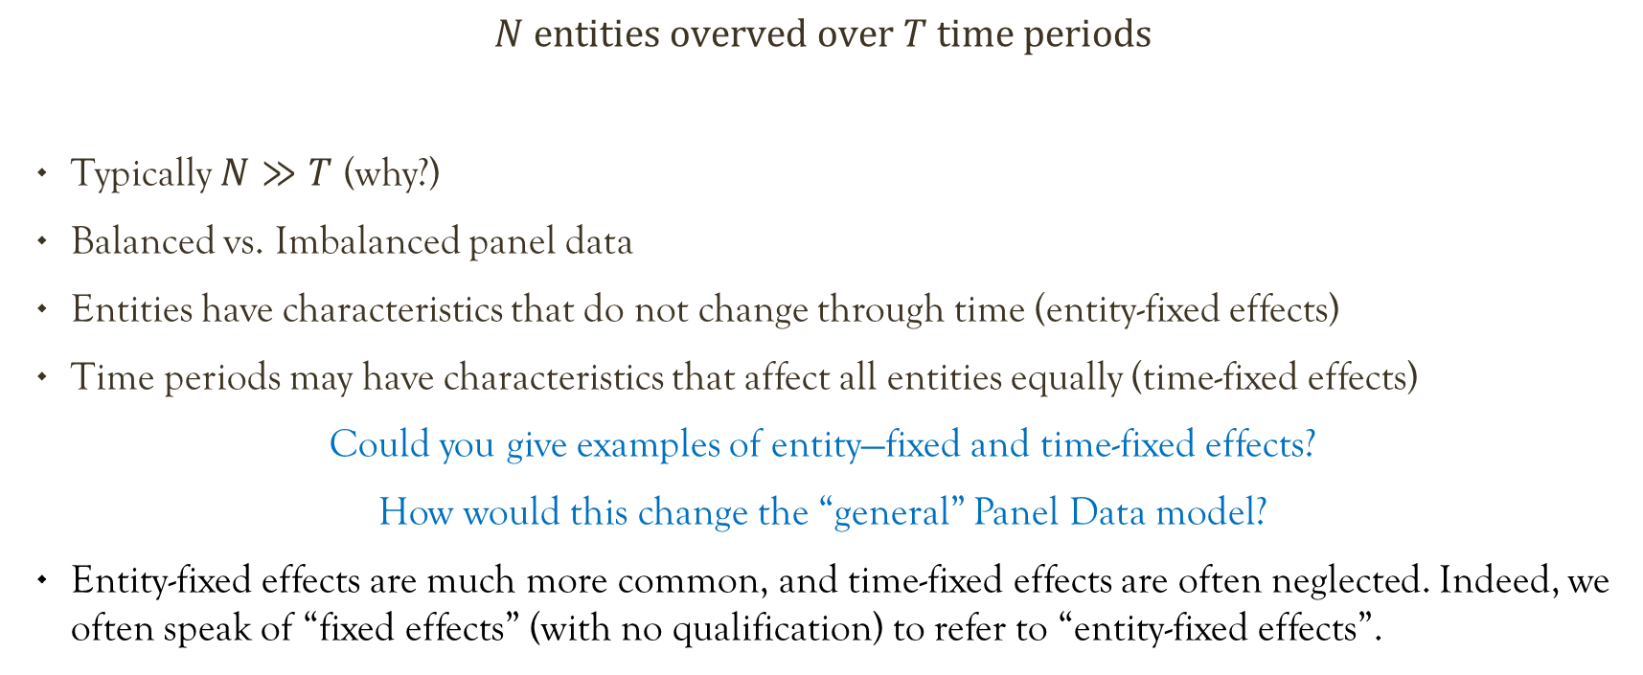
Scattered comments about panel data
$$N entities overved over T time periods$$
Typically $N≫T$ (why?)
Balanced vs. Imbalanced panel data
Entities have characteristics that do not change through time (entity-fixed effects)
Time periods may have characteristics that affect all entities equally (time-fixed effects)
Could you give examples of entity—fixed and time-fixed effects?
How would this change the “general” Panel Data model?
Entity-fixed effects are much more common, and time-fixed effects are often neglected. Indeed, we often speak of “fixed effects” (with no qualification) to refer to “entity-fixed effects”.

